Slide 1
Invasive Species

Slide 2
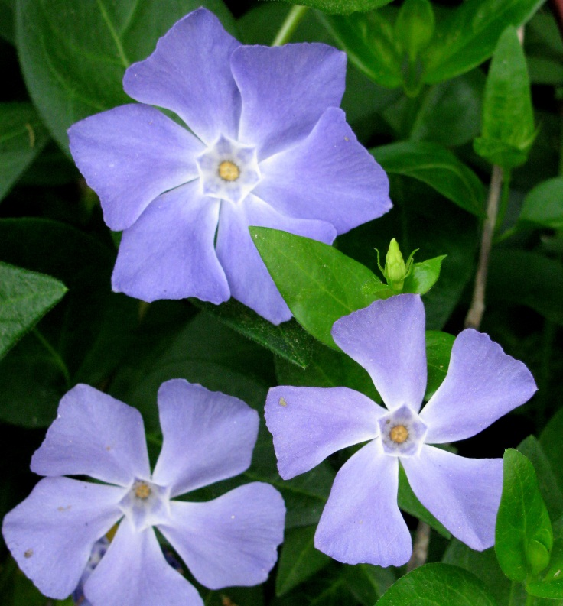
Invasive Species
What is an invasive species
Why does a species become invasive
Invasive Species in South Carolina
What can we do?
Vinca sp. Photo by J.DuRant

Slide 3
Invasive Species: Terminology
Native: an animal or plant species that occurs naturally in a region, habitat, or ecosystem
Introduced Species: an animal or plant species that is not naturally occurring in the area where it is growing and has been moved by humans across a geographic boundary
Naturalized: an animal or plant species that is growing and reproducing successfully in an area where it has been introduced
Invasive Species: an introduced animal or plant that is causing (or can/will cause) ecological or economic damage within the new ecosystem

Slide 4
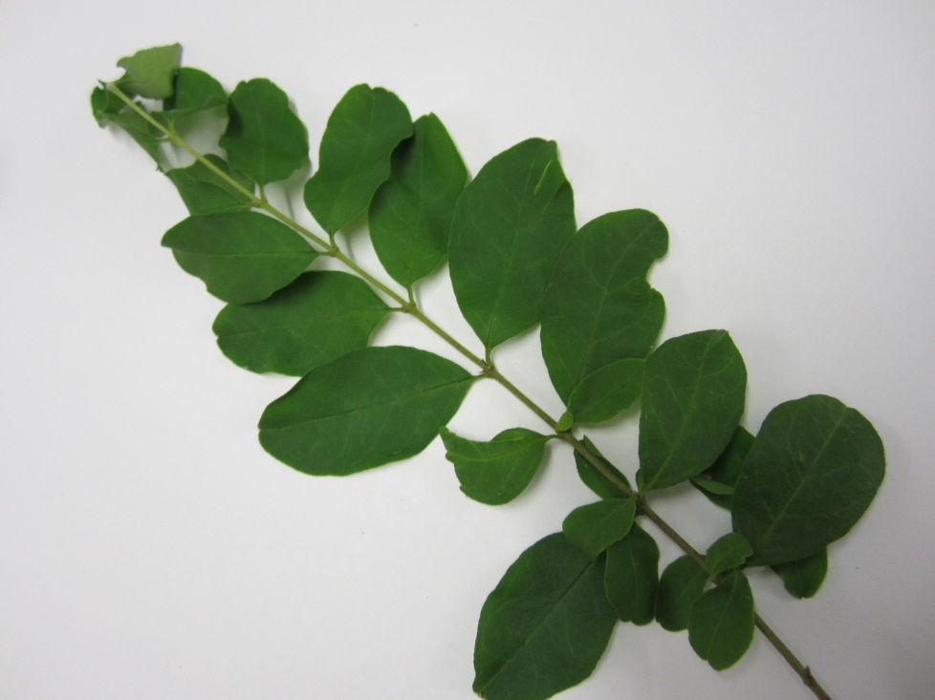
Simplified
An invasive species is an animal or plant that has been moved from its original habitat to a new one, and is causing environmental or economic harm in its new environment
Privet. Photo by J.DuRant
Notes:
The photo is Privet

Slide 5
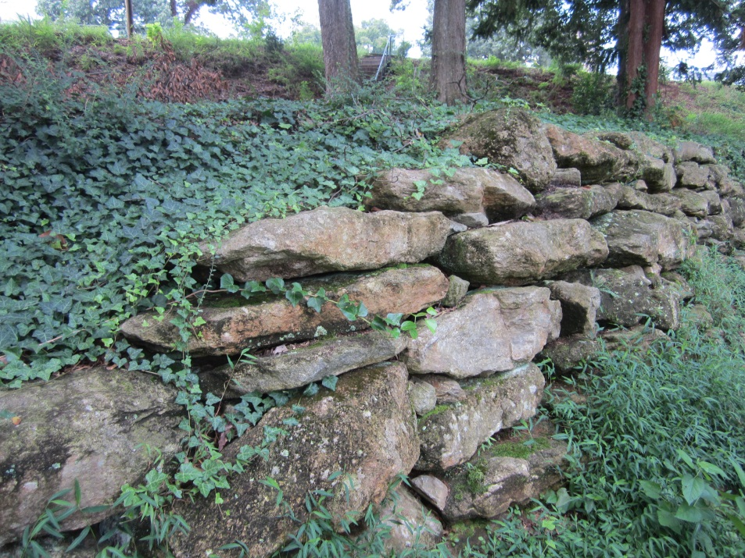
Invasive Species in the Urban Environment
We love to move things around!
And that isn’t always a bad thing. Many of our landscape and crop plants are introduced species, and as long as they don’t “escape” and cause harm, there is nothing wrong with that.
English Ivy in McPherson Park. Photo by J.DuRant
Notes:
Many invasive species where purposely brought into the environment in which they eventually became a problem. Invasive plants and animals are introduced for a variety of reasons: as landscape plants, to control soil erosion, to provide food for animals or people, or even to control other invasive species. Sometimes introduced plants and animals do what they were brought in to do and don’t become a problem. Other times, they become invasive.

Slide 6
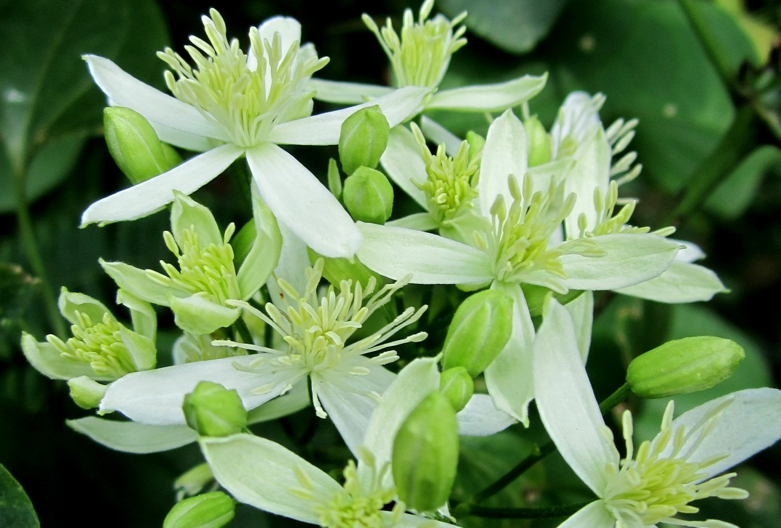
Invasive Species in the Urban Environment
Urban environments (such as the edges of roads and vacant lots) are ideal places for invaders to grow, and can help increase the spread of invasives. These spaces are generally open with lots of sunlight and recently disturbed soils.
Invasive Clematis vines along the Swamp Rabbit Trail. Photo by J.DuRant

Slide 7
Some statistics
Hawaii: 95% of plant species loss caused by invasive species (93 extinct, 40 endangered out of 1126 natives)
Guam: Brown tree snake accidentally brought from New Guinea (military vessels?) has caused extinction of 9 of 12 native birds, 6 of 12 native lizards, and 2 of 3 bats…also enters homes and bites sleeping babies
68% of the extinctions of native fish in North America caused by invasive species
South Carolina spends 2.5 million yearly to control the invasive aquatic weed hydrilla alone
US spends more than 138 billion per year controlling and removing invasive species

Slide 8
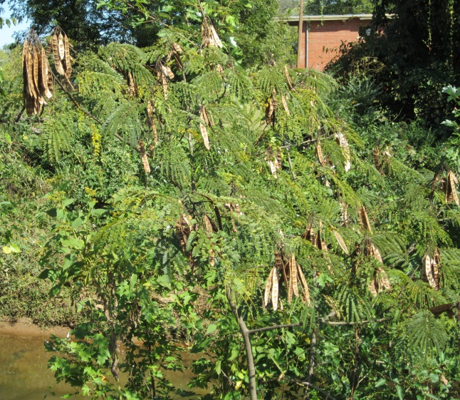
Why do some species invade and others don’t
Usually a combination of factors such as
Fast growth rate
Escape from predators/pathogens/competitors
Able to grow in a variety of habitats
Seeds abundant, resilient, and/or easily dispersed
Variety of reproductive strategies
Chemical warfare
toxic to herbivores or other plants
Mimosa with seed pods. Photo by J.DuRant
Notes:
It is difficult to know why some plants become invasive while others don’t, but invasive species often display a combination of these characteristics

Slide 9
Damage caused by invasive species
Alter natural community structure
Loss of habitat for native animals and plants
Loss of food sources for animals (trophic cascades)
Alteration of ecosystem processes (hydrology, fire dependency, nutrient cycling, etc.)
Economic damage: crop damage, increase in need for chemical control methods, expensive removal projects

Slide 10
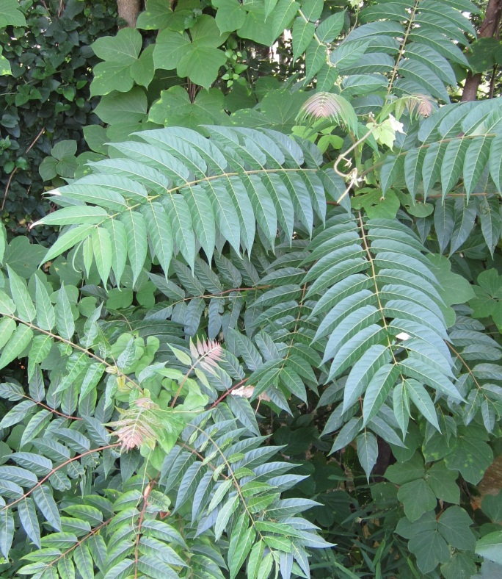
Where do they come from?
Hitchhikers (ride on boats, airplanes, or in packages)
Agriculture
Landscape plants
Introduced to control another species
Pet trade
Tree of Heaven. Photo by J.DuRant

Slide 11
What can we do?
Learn to identify invasive species
Plant native species
Never dump a plant/aquarium/pet in the wild
Clean hiking, sampling, fishing, boating, and other equipment well between trips
Make sure current landscape plants are well contained and controlled
Removal projects

Slide 12
Invasive TREE Species in Greenville
Princess Tree
Mimosa
Tree of Heaven
Chinaberry
Chinese Parasol Tree
White Mulberry
White Poplar
Bradford Pear

Slide 13
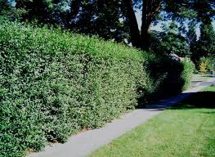
Invasive SHRUB species in Greenville
Scotchbroom
Japanese Privet
Chinese Privet
Thorny Olive
Multiflora Rose
Japanese knotweed
European Privet
Nandina

Slide 14
Invasive VINE species in Greenville
Wisteria
Kudzu
Japanese Honeysuckle
Vinca (periwinkle)
English Ivy
Japanese climbing fern
OTHER Plants:
Cogon grass
Queen Ann’s Lace
Bamboo

Slide 15
Not a complete list!
http://www.se-eppc.org/southcarolina/scinvasives.pdf
http://threatsummary.forestthreats.org/browse.cfm?stateSearch=SC
Aquatic invasive species (mussels, snails, shrimp, fish, plants)
Invasive terrestrial animals
Brown Marmorated Stink Bug
Green Mussel
Apple snail
Kudzu Beetle
Hemlock Wooly Adelgid
Feral Pigs

